Slide 1
What are you wearing?
Silvia Feješová

Slide 2
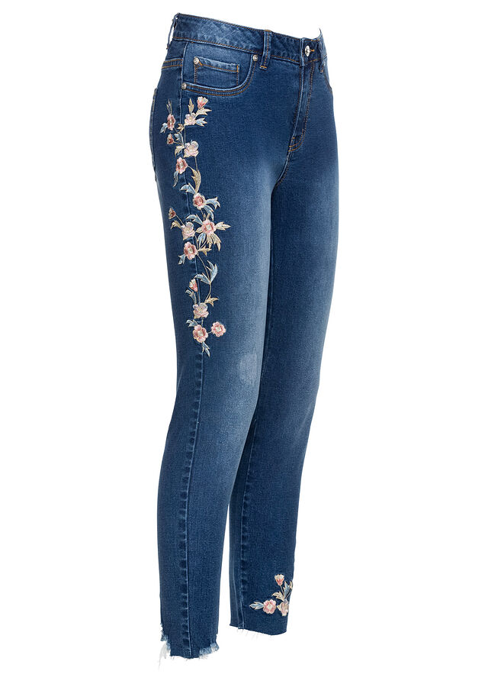
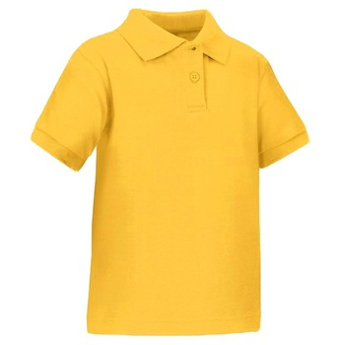
I´m wearing
a blue jeans and a yellow T- shirt.

Slide 3
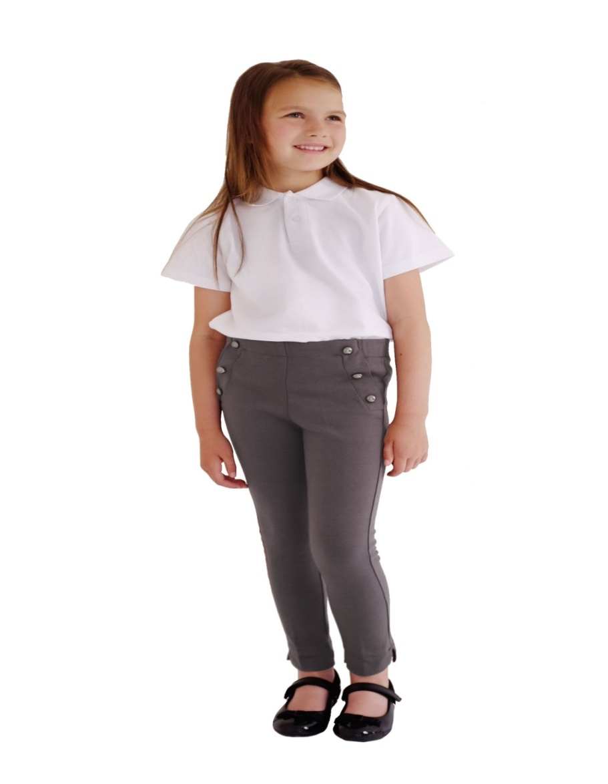
I´m wearing
a grey trousers, a white T-shirt
and a black boots.

Slide 4
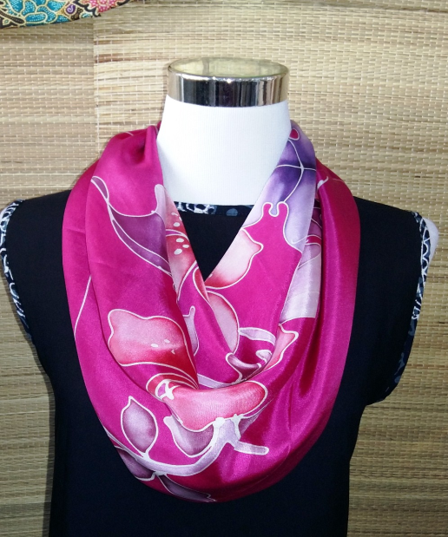
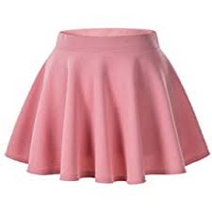
I´m wearing
a rose skirt, a black shirt
and a purple scarf.

Slide 5
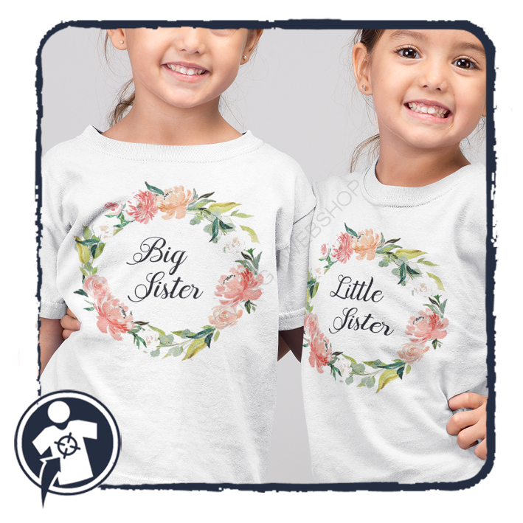
I´m wearing
a white T-shirt.

Slide 6
Thank you for watching.

