Slide 1
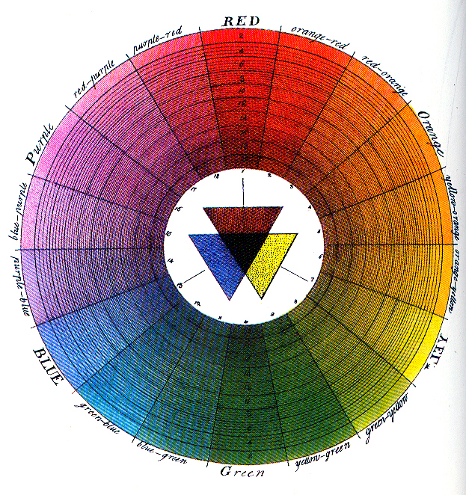
Color theory
Klaudia Králová III.GMB
.

Slide 2
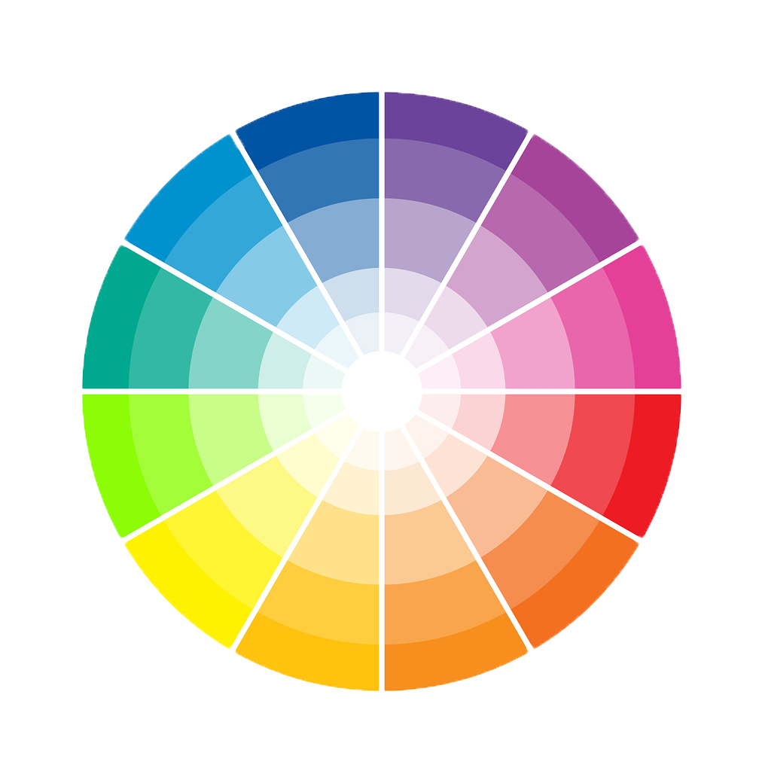
Color wheel

Slide 4
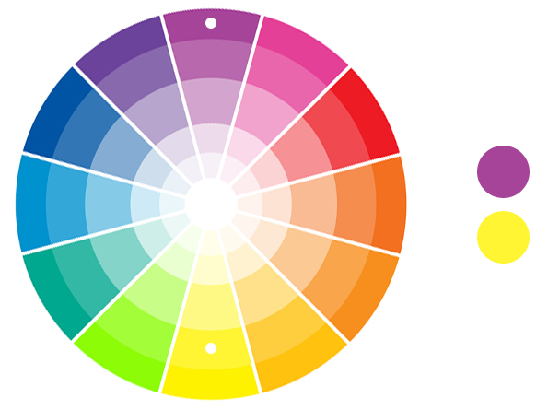
Complementary colors

Slide 5
Analogous colors

Slide 6
Thanks for your attention
☺

Slide 7
Color wheel is a circle with different colored sectors used to show the relationship between colors.
Primary color - red, blue, yellow
Secondary color - colors which are created by mixing primary color
Tertiary color – are created when we mix one primary and one secondary color
Complementary colors – “opposite colours”
Analogous colors –are next to each other the color wheel

